Slide 1
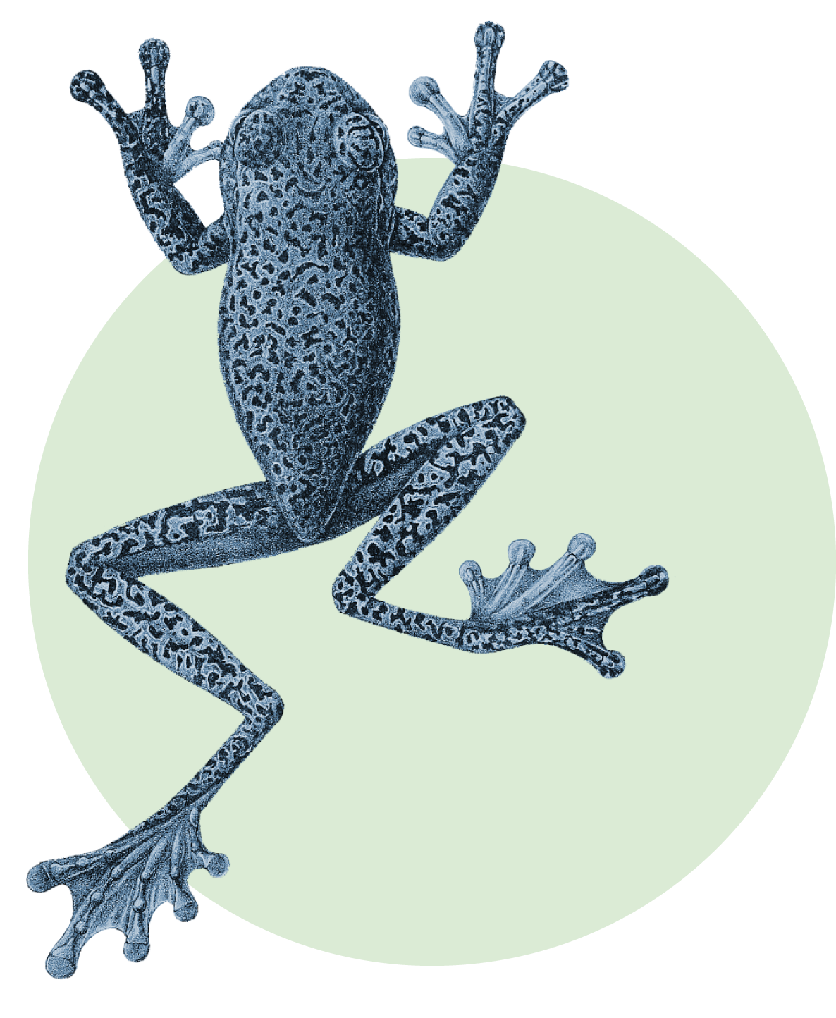





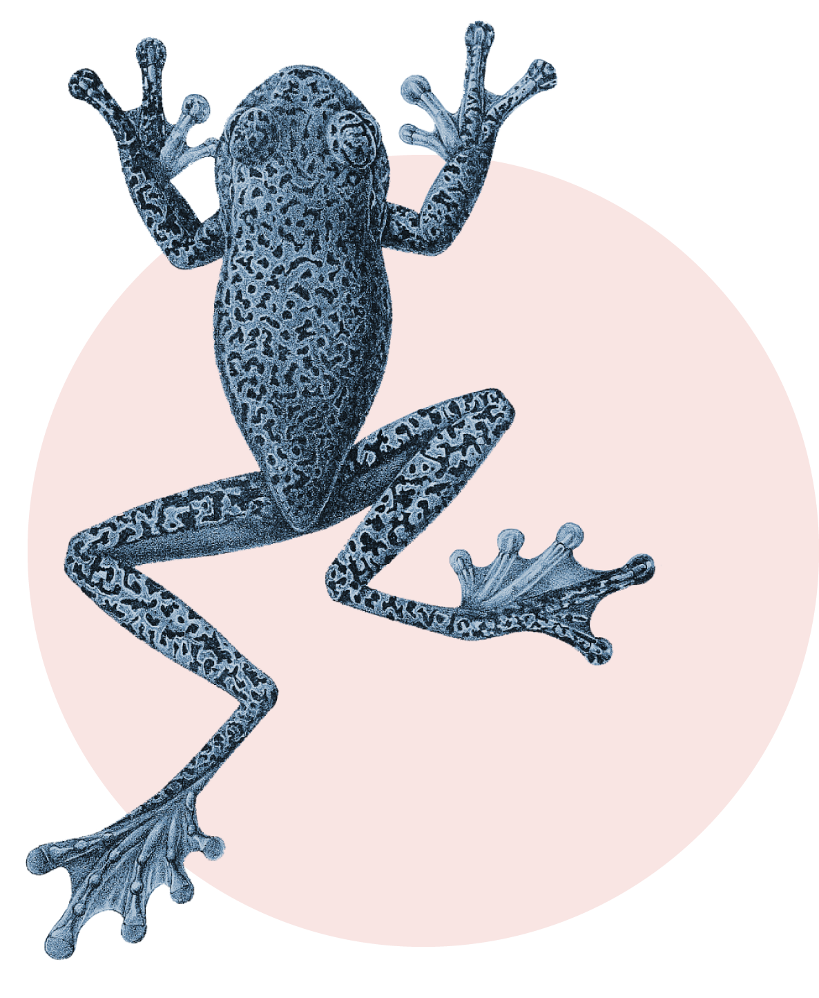

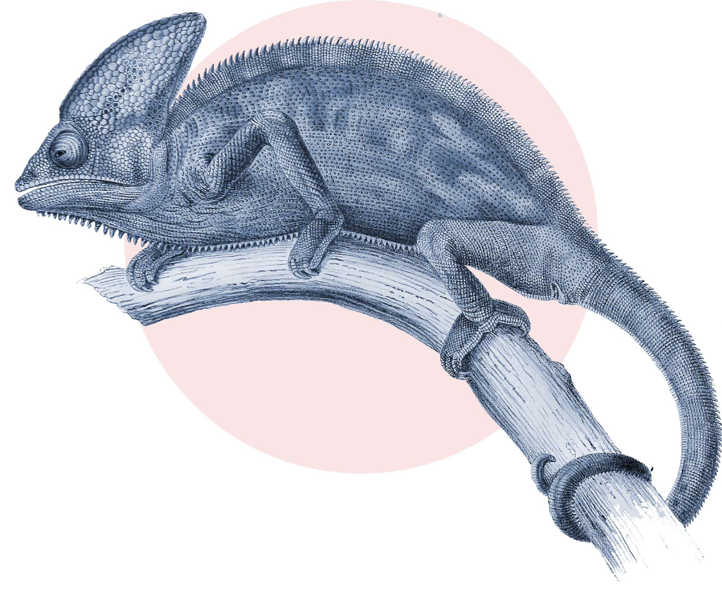
Collages
Use them freely in your presentations when in need of some visual relief or to complement an idea. You can resize them but try to keep them inside the red grid. 😊

Slide 2









Collages
Use them freely in your presentations when in need of some visual relief or to complement an idea. You can resize them but try to keep them inside the red grid. 😊

Slide 3



Collages

Slide 4



Collages

Slide 5



Collages

Slide 6

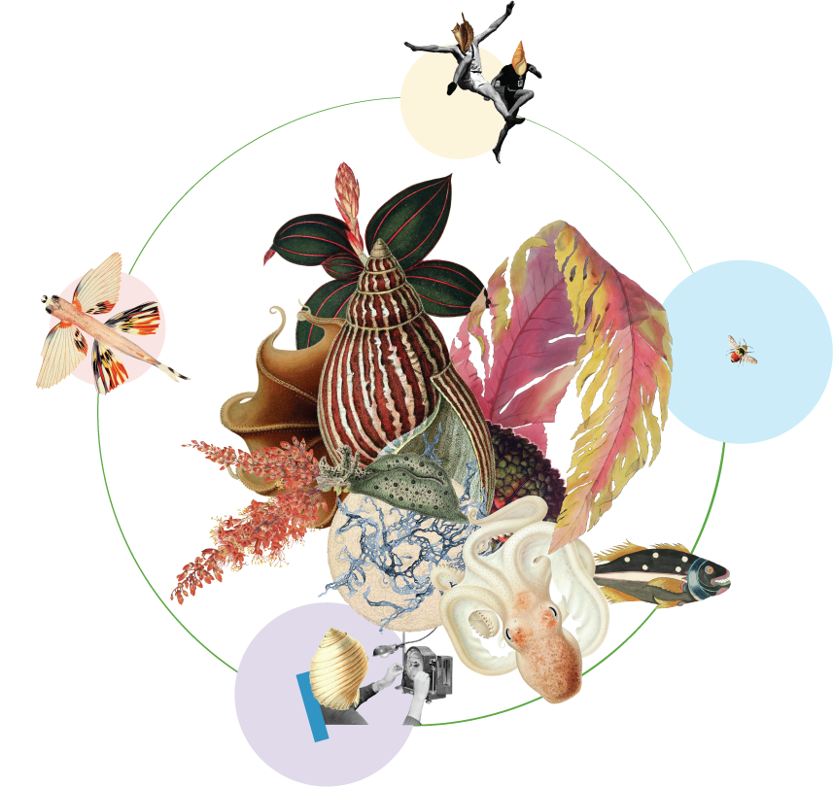
Collages

Slide 7



Collages

Slide 8



Collages

Slide 9




Collages

Slide 10

Collages GB31

Slide 11

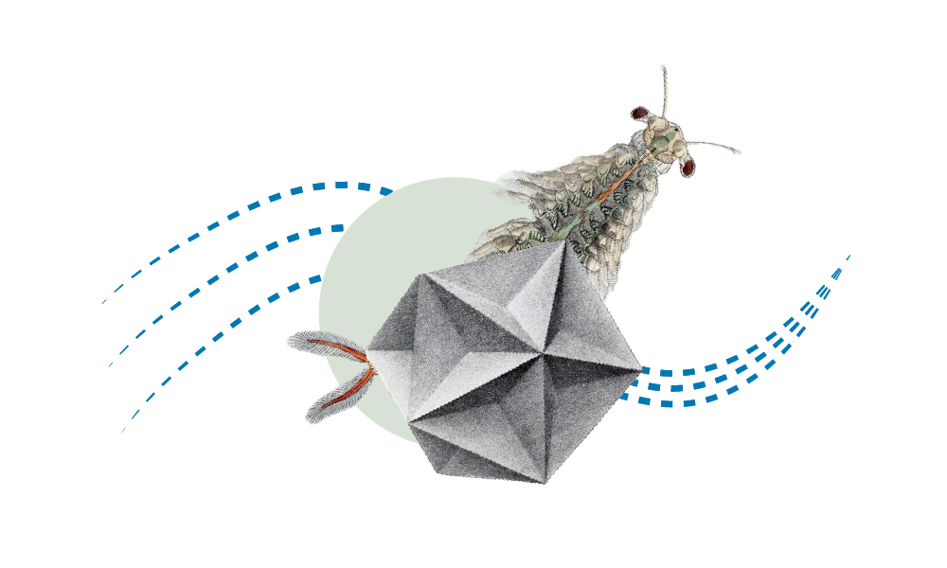

Technical documentation

Slide 12
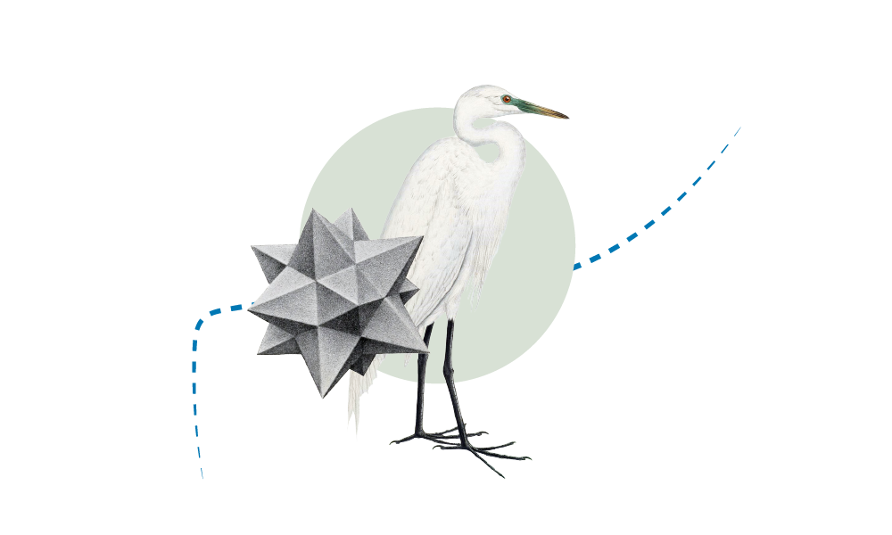
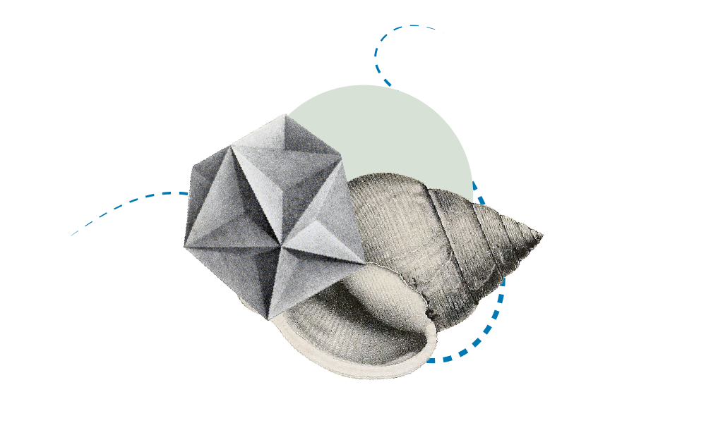
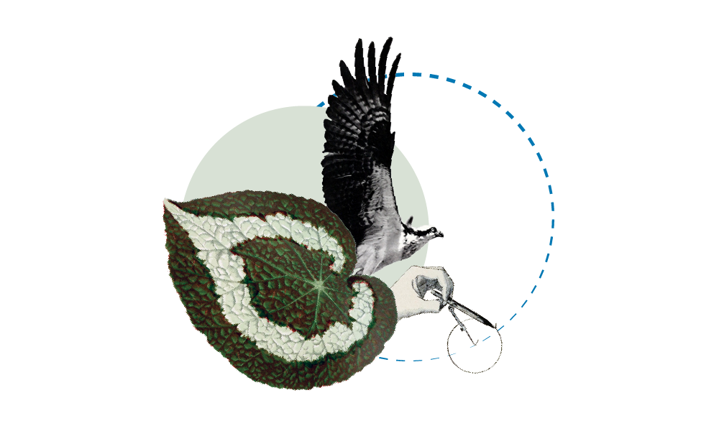
Technical documentation

